Slide 1


6th Grade Expectations

Slide 2

Essential Question
What do I need to know to be successful and reach my full potential next school year?

Slide 3

Parent Teacher Student Association
(PTSA)

Slide 4

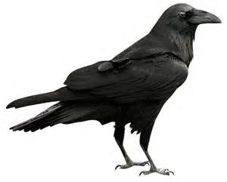
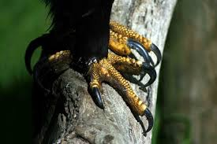

Raven Claws
Be Respectful- To students and staff
Be Responsible- Be accountable and dependable
Be a Problem Solver- Always look for solutions to problems

Slide 5
Positive Behavior Supports @ CSRMS
Being:
Respectful –
Responsible –
& a Problem Solver –
Demonstrating these characteristics will earn students “Raven Claws which are part of a token economy system that will allow students to purchase snacks, items from the school store, as well as other rewards for making great choices!

Slide 6
Positive Academic & Behavior Supports @ CSRMS

Slide 7
Positive Academic & Behavior Supports @ CSRMS
Benefits of Being On-Track?
Participation in On-Track Celebrations when Progress Reports/Report Cards are issued!
Free Admission to Select Sporting Events throughout the School Year
Access to Atrium Seating during lunches
Priority Access to Lunch Lines
And more…

Slide 8
How Can You Help Monitor Your Student’s Progress @ CSRMS?
Be Positive = Help your child to maintain a “can-do” attitude!
Be Prepared = Help by checking their planner, help by monitoring completion of homework, and by cleaning out their backpack on a weekly basis
Be Prompt = Remind your student(s) that passing is for walking to their next class, not for hanging out with friends.
Be Committed to Quality = Help your student to always do their best & check work before handing it in for a grade
Be Present = Remind your student that you will be with them for the next three years and that you are committed to their success by monitoring both their grades as well as their communications with their friends/schoolmates

Slide 9
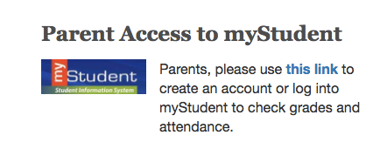
MyStudent -
An online grade book that allows students and parents to monitor student progress,
review what has been covered in each class, and in some cases, lists what is planned
for the upcoming days/weeks.
Preferences allow parents and students to receive communication via email/text
message when grades have been entered or when grades fall below a specified level.
Students and parents can establish their own account
Students must register at the beginning of each school year
In order for students/parents to register, you will need the following information:
e-mail address
student’s birth date and social security number
Sign up for an account after school starts in August.

Slide 10

Electronics Policy
These rules are specific to common areas such as cafeteria, hallways,
bathrooms, locker rooms, track, bus and car loop, etc.
Students are responsible for their own devices. Do not lend your phone
or borrow a phone from another student.
All electronic devices should be kept on Silent Mode. Not complying
with this rule will result in disciplinary action.
Students are allowed to use electronics in the hallways and cafeteria freely
as long a they abide by the rules above.
Electronic privileges can be revoked if students do not respect the policies
and procedures in place.

Slide 11
Electronics Policy - continued
There is absolutely no use of electronics allowed in any restrooms or
locker rooms. Electronics should be put away at all times.
Taking of pictures or videos is not allowed on campus unless authorized by your
teacher for educational purposes.
Making phone calls is prohibited from the moment you come on campus
to the moment you leave without explicit permission from a school staff member.
If you need to use a phone, go to the front office or get permission first!

Slide 12



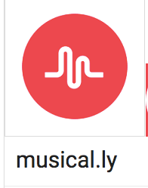
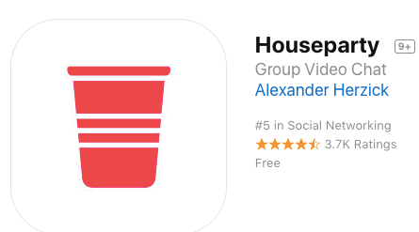

Does your student have ANY
of the Following Apps on their
phone?
Our Recommendation is that students NOT be allowed to download apps without parent permission and that parents should be the only ones with the password to the android/apple/google store!

Slide 13

Student Supplies
Please remember that we don't have lockers for the students. Students will carry all their supplies, books, and belongings all day to each of their classes. Therefore, always consider trying to buy the lightest and least bulky products to save space and weight in your child’s backpack.
As well, please always make sure to provide your student with basic materials such as:
Pens/Pencils
Paper
Folders
Binders/Notebooks

Slide 14

Student Attendance
There are only 180 school days in an academic year.
If a student misses:
1 day of school = they miss 270 minutes of instruction
3 days of school = they miss 810 minutes of instruction
5 days of school = they miss 1,350 minutes of instruction
10 days of school = they miss 2,700 minutes of instruction
15 days of school =they miss 4,500 minutes of instruction

Slide 15

Student
Attendance
When possible, please provide 24 hours notice of absences. An online form is available on our school website to notify us of your child’s absence. If the absence is planned, please email the principal and team teachers.
Students are responsible for any missed work.
Excused absences are granted for:
Illness of the student or major illness of an immediate family member
Death of a student’s immediate family
Religious holidays; religious instruction
Trips deemed appropriate by the principal and approved in advance

Slide 16
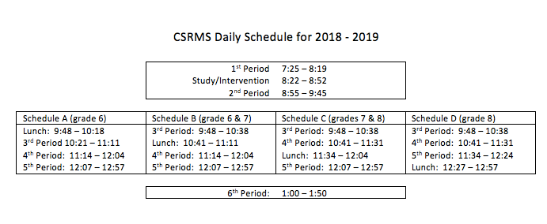
Bell Schedule
The 1st floor is the location for the 6th grade teams. There are other classes stationed outside in the portables as well. (Research/Health)
The 2nd floor is primarily 7th grade teams, including reading and some elective/CCTE classes.
The 3rd floor is primarily 8th grade teams, including some CCTE/Elective/Foreign Language classes.

Slide 17
AIR Time (Study Hall/Intervention Time):
Each day, students are provided with a 30 min. time period in which they can get academic support.
Students will be scheduled with one of their team teachers (LA, MA, Sci, SS, or Elective Teacher assigned to their team) and are allowed to complete assignments, ask for assistance on misunderstood concepts, and move from one subject area teacher to another depending on the students need.
NO Excuses for Missing Work!

Slide 18
Student Activities (Subject to change)
6th Grade students can participate in the following sports:
Football, Volleyball (Girls), Basketball (Boys/Girls), Soccer (Boys/Girls), Track (Boys/Girls)
Students Working Against Tobacco (SWAT)/
Fellowship of Christian Students (FCS)
National Junior Honor Society
Student Council
Builders Club
Thespian Club
Odyessey of the Mind
Chess Club
Color Guard Club
Travel Club
Book Club

Slide 19


Supervision
School Hours officially begin at 7:25 a.m. and end at 1:50 p.m. (SUBJECT TO CHANGE). There is a warning bell that rings 15 minutes prior to the beginning of class.
Students are not allowed in the building until 7:05 AM
The only exception to this is when we start to have cold weather. Students are then allowed to enter the building earlier and remain in the first floor atrium until the bell rings.
Students must not be on campus more than 30 minutes before school (6:55 AM) or more than 30 minutes after school (2:20 p.m.) without permission from a staff member.

Slide 20
.

Slide 21

CSRMS is a Bully-Free School
Bullying is repeated unwanted, aggressive behavior among school aged children that involves a real or perceived power imbalance.
If bullied, the following steps will be taken:
Student reports to adult at school.
School investigates (speak with students).
Staff Documents to track patterns of behavior.
Staff Implements appropriate intervention.
If continues:
Contact parents -Involve Corporal and various staff support services
No Contact Agreement is established
If still continues:
Review patterns of behavior, contact both parents
Involve Corporal and various staff support services
More serious consequences are given to terminate this behavior
The most important rule of thumb is: If we don’t know, we cant help!
Don’t be afraid to end bullying, tell an adult anytime you or someone
you know is dealing with this situation and you can help stop bullying!

Slide 22
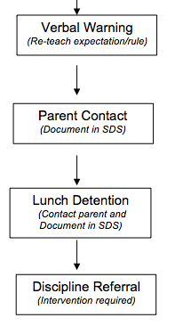
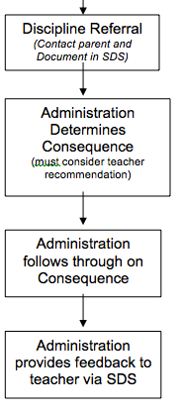
Disciplinary Action-Referral System
Teacher Based
Office Based
Gum
Tardies
Electronic devices
Cheating or Plagiarism
Talking in class
Sleeping in class
Drinks/Food in class
Abuse/Misuse of technology *
Public display of affection*
Calling out
Inappropriate attitude *
Refusing to do work
Put downs
Inappropriate comments
Refusal to follow a reasonable request
Dishonesty *
Harassment *
Fighting or aggressive physical contact
Possession or selling tobacco, drugs or alcohol
Possession of weapons, matches or lighters
Threats
Bullying
Harassment
Aggressive language
Abuse/Misuse of technology
Skipping class
Vandalism
Major disrespect
Public display of affection
Chronic classroom disruptions
Theft
Campus disruption
Truancy
Dress Code
Dishonesty
Misuse of the elevator
Throwing/Propelling objects
Chronic minor infractions

Slide 24
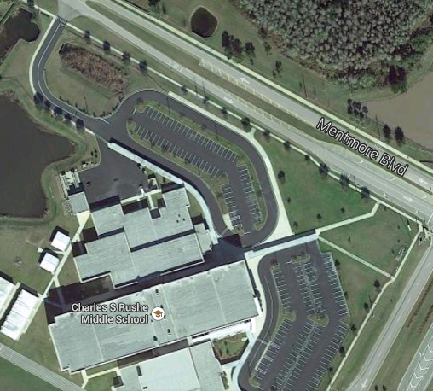
Walkers
Walkers who need to cross Mentmore Blvd. must cross at the crosswalk by the light.
If walking west (toward the clubhouse) you must use the walkway that runs in front of the cafeteria and winds around to Mentmore.
If participating in the after school program at Imagine, please use the sidewalk in front of the school and cross at the light by the high school.

Slide 25
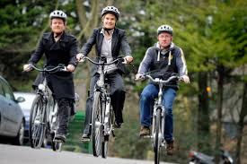
Bike Riders
Bike Riders must lock their bikes inside the bike rack. You can also register your bike by downloading the Bike Registration form from our web site.
State law requires all bike riders under the age of 16 to wear a helmet.
For your safety, please walk bikes on/off campus - no riding on campus.

Slide 27

Your Options are LIMITLESS…
And only You can make it happen! You are a Raven, and Ravens Soar to Success!!

